Slide 1

Project Lighthouse
Kurt Newcomb CST-451 & CST-452 Professor Amr Elchouemi

Slide 2
Project Overview
The vision for the capstone experience is to develop a project that can be used to demonstrate individual knowledge, skills, and abilities within a specified field as well as communicate to both technical and non-technical audiences. The capstone project will be a tangible artifact students will refer to when interviewing for a job or enhancing their career options.
In order to accomplish this task I chose to develop an application using Android Studio and writing the application in the Java language. This provides a good crossover for the audiences, both technical and non-technical, as Android applications are used by a wide-variety of skill level users.

Slide 3
Project Intent
My intent for the project is to design a journaling application with the purpose of helping people who struggle with overwhelming emotions and the stress that accompanies them.
I got the project name Lighthouse, from the concept of helping provide a light to go towards during dark times, like a ship looking for a lighthouse a night or during a storm.

Slide 4
How do I accomplish this?
On of the worst things that stress does is pull people into a cycle of rumination.
The application aims to counter this cycle by engaging the user in critical thinking and analysis rather than simple reliving the experience from an emotional perspective.
With time, hopefully the user starts to develop the ability to start doing this process in real time, rather than having to do it afterwards.

Slide 5
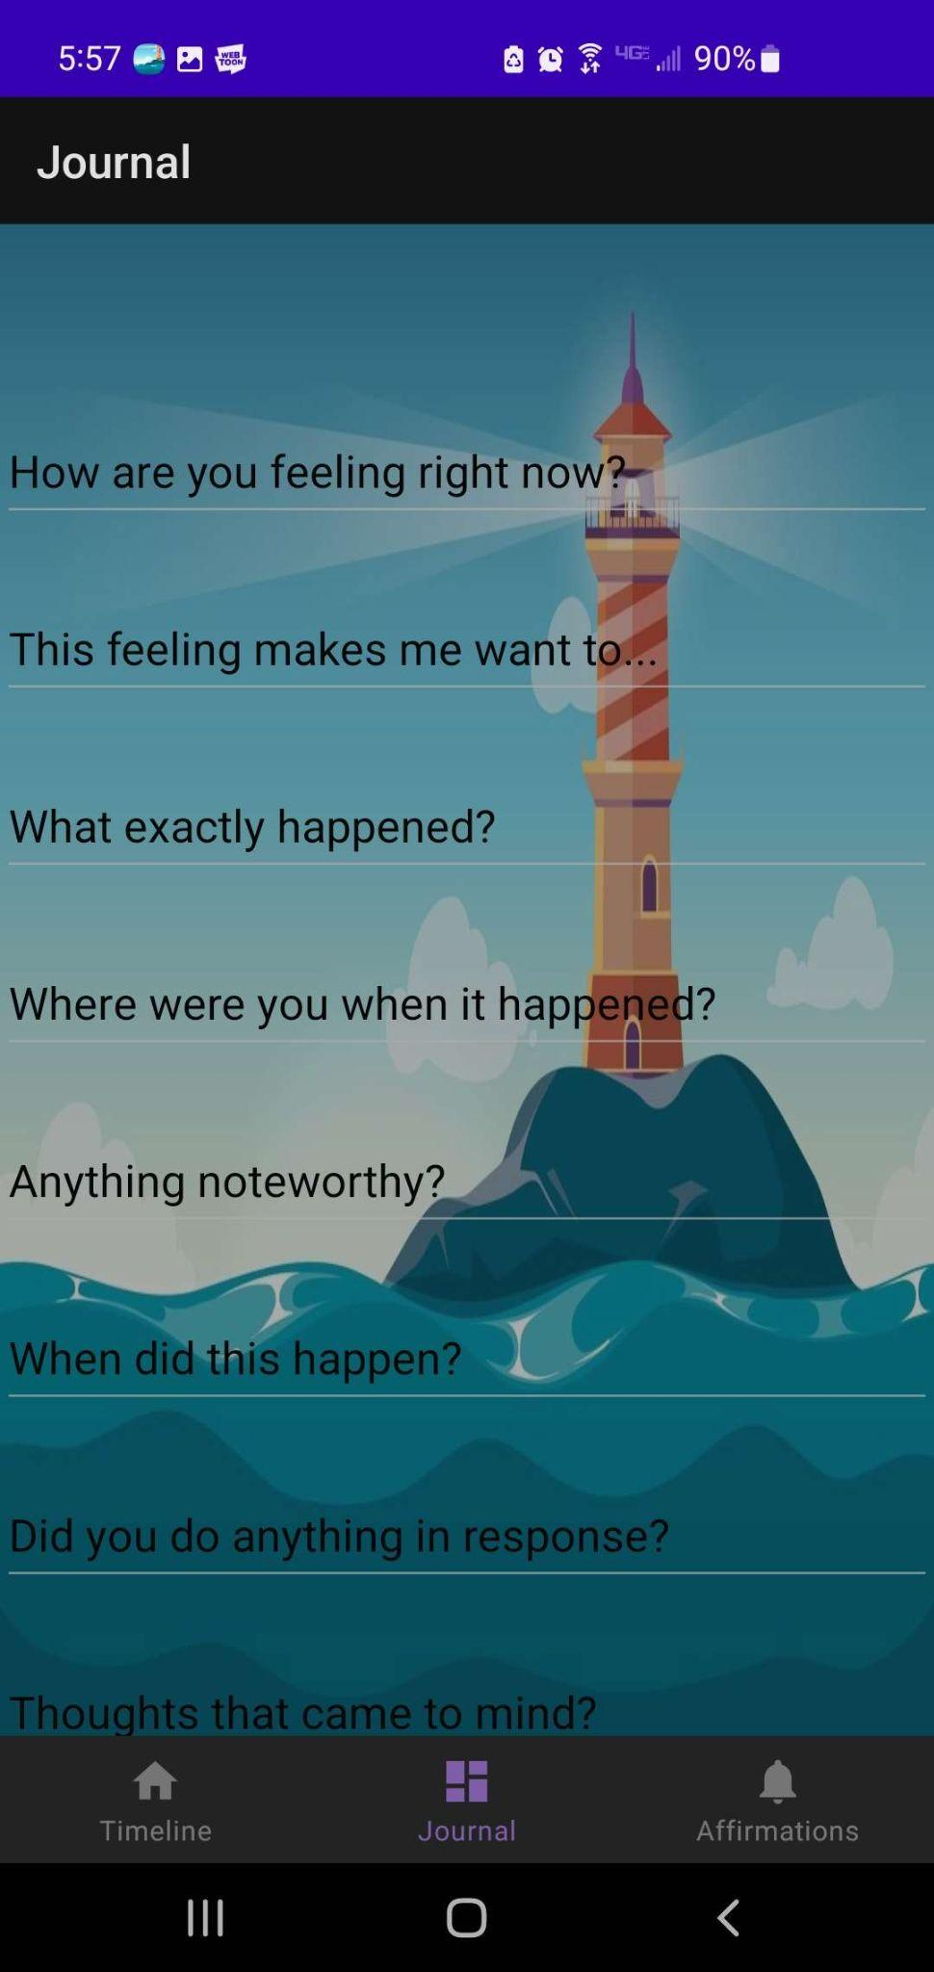
Menu #1 - The Journal
This is the page where the user “talks” about their problems, or in more application relevant terms “journals” their experience.
This process helps them engage the logic center of their brain, thus lessening the overwhelmingness of the emotion.
After they do this, they submit it to the timeline section of the application.

Slide 6
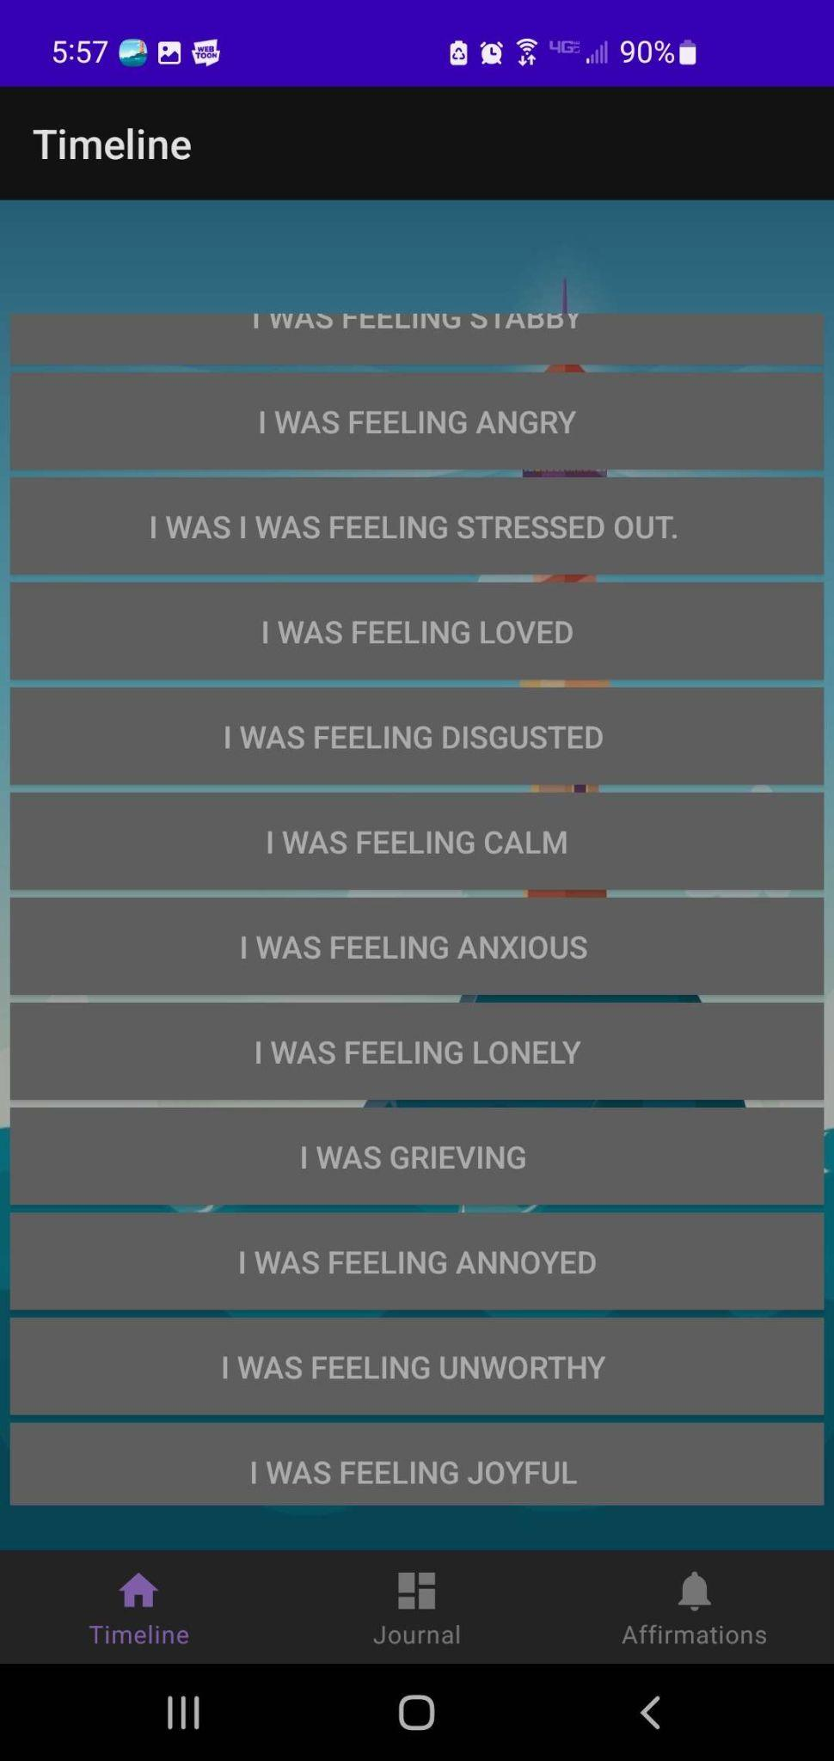
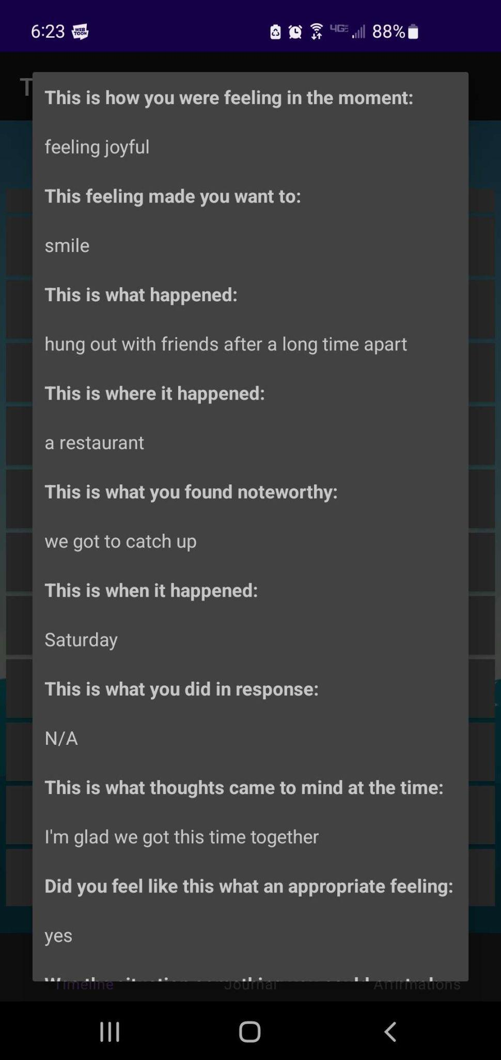
Menu #2 - The Timeline
In this menu (Figure 1), you can see a list of all the experiences that the user has entered in the past, with a simple summary of what they were feeling at the time.
If the user wants to view the precise details they entered previously, they can click the memory and view a dialogue with all of the details. (Figure 2)
Figure 1
Figure 2

Slide 7
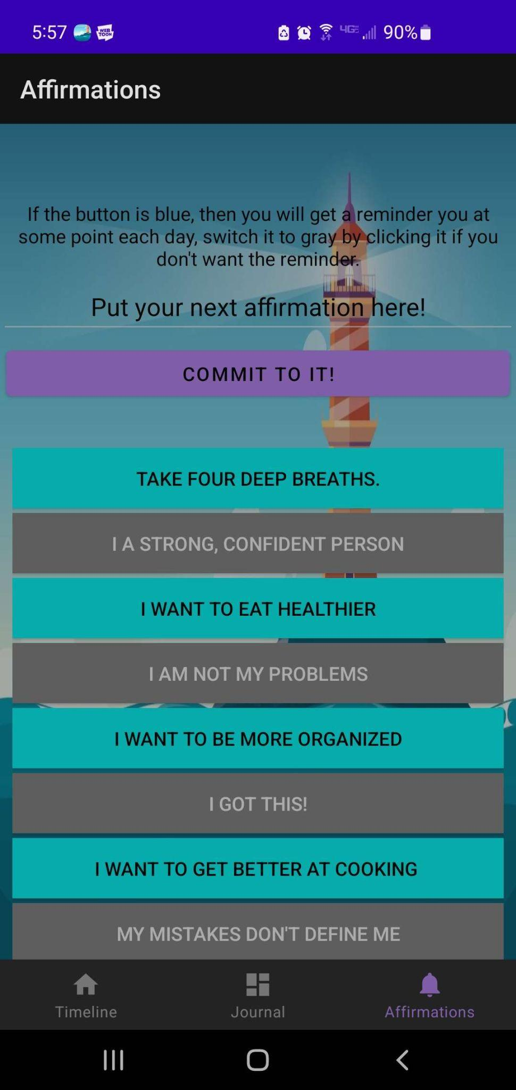
Menu #3 - The Affirmations
This is the other big aspect of the application. This menu allows the user to set goals/affirmations for themselves, and gives them a place where they can go to remind themselves of them.
Reasoning:
It’s always important to keep your eyes on the goal, and not get bogged down by all the things that have gone wrong up until this point.

Slide 8
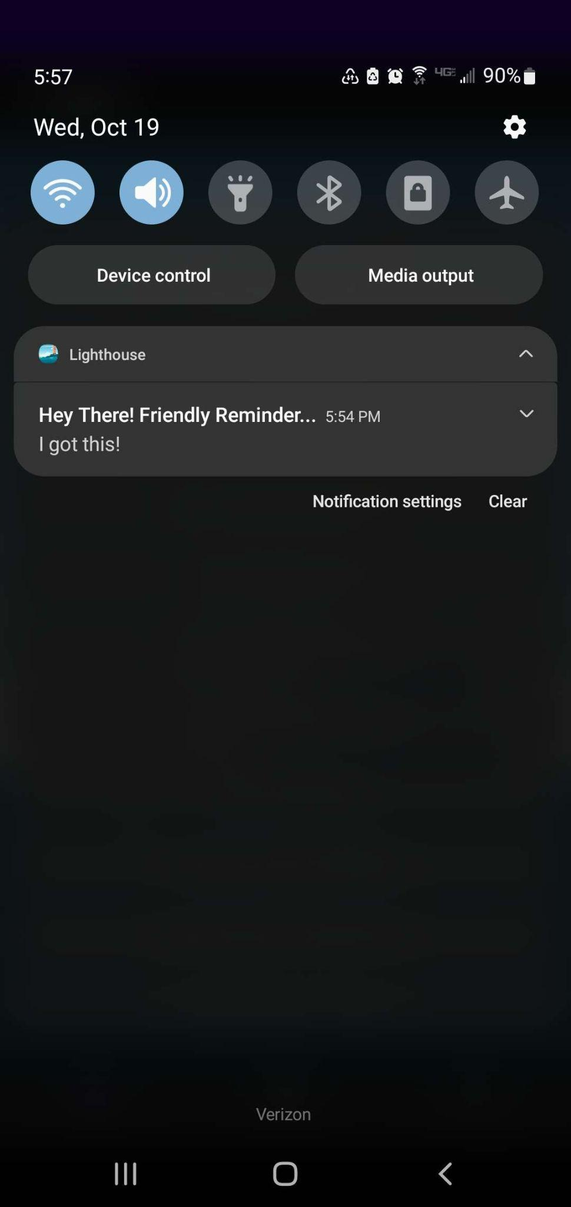
Menu #3 Part 2 - Notifications
The last current piece of functionality currently in the application, is the affirmation reminders. When an affirmation is enabled (aka, set to cyan), the application schedules a notification to be pushed to the users device at a random hour each day until disabled.
Reasoning:
The reason it is important to remind the user is that, most of the time, the feelings that they are having problems with are negative, so in order to help overcome them, the user will be reminded of the positive things in life.

Slide 9
Where I struggled?
As it happens most of my struggle was actually just getting the development environment to cooperate with me. For the first couple weeks, getting the IDE and virtual device to even run my application was phenomenally difficult and for a large portion of the time, downright impossible.
As far as aspects of the application that were the most difficult, it was actually the scheduling of the notifications that proved to be the most challenging. I am not an Android expert, so trying to get the application to interact with the device even when it’s closed is actually harder than anticipated.

Slide 10
Christian Worldview…
Even though this is a school project for a grade, I created this project with the purpose of helping three specific people who are very close to me that all suffer from anxiety, stress, and overwhelming emotions.
That being said, I realize that as I continue to put effort into this(even when this class is over), then eventually it might reach a point where I can feel good about putting it out there on the Google Playstore so others might be able to use it to help themselves as well, all for free.
I want people to be able to stand up to hardship and adversity all on their own, but sometimes people need help, so if this application can give them what they need, then I feel like it’s the least I can do.

Slide 11
Ideas for the future…
Currently, the journal interface is entirely free-form. However to facilitate ease of use and overall clarity, and even perhaps help facilitate so cool timeline functionality, I can replace the simple text inputs with radio button or drop-down selections. While, technically they do eliminate some of the users freedom, sometimes they’d rather just click a simple option instead of having to type everything out themselves.
I also would like to implement the ability for the user to schedule their own positivity notification reminders whenever they want them. The reason it’s currently random is because from personal experience, people struggling with the issues lack the capacity to handle reminding themselves, so doing it at some random point in the day, helps their brain into establishing it as an expectation, and when it becomes an expected behavior, it them becomes more memorable.
Even more ideas for improvement are also in the works, such as a breathing synchronizer, or a list of exercises that a user to practice to help with things like rumination
Note: I am not an expert therapist or anything like that, but who knows, maybe I can reach out to some and get some good development advice from actual professionals, and maybe even perhaps end up with a tool that can use with their clients to help them.

Slide 12
The End

